Slide 1
Security System By Face Recognition
CS-34
Mina Gerges Foukeh
Abanob Ashraf Hanna
Supervised by.
A.P. Walaa H. Elashmawi
T.A. Manar Elshazly

Slide 2
Introduction
Security System by face recognition
It’s a system can help police in their interrogations
Which facilitate their job

Slide 3
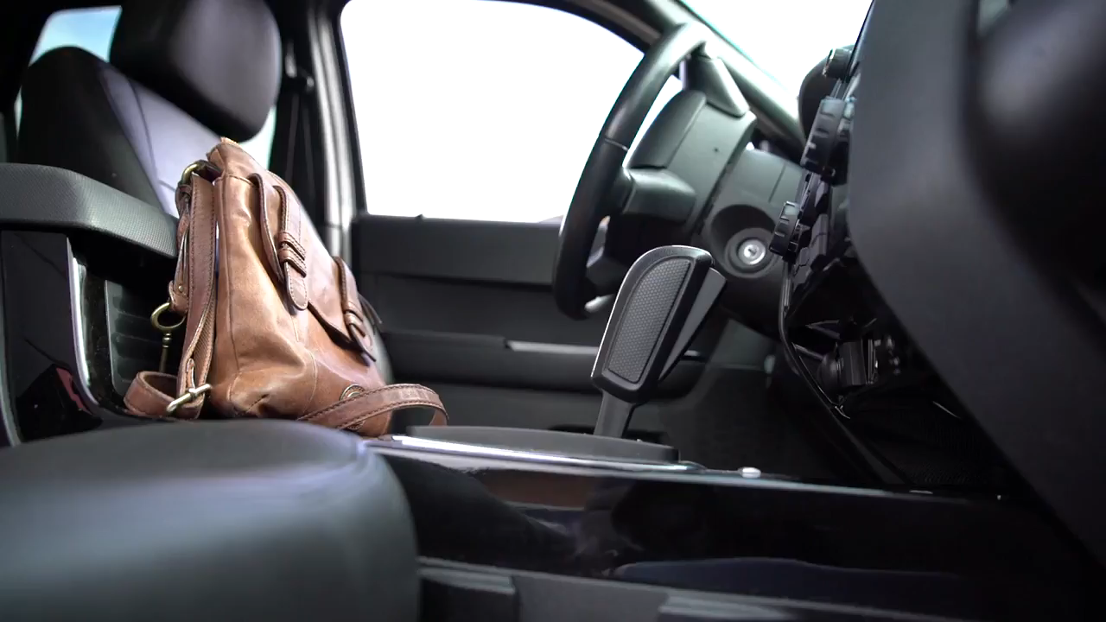
Problem Definition

Slide 4

Solution Approach

Slide 5
Tools
Python
Deep Learning
SQL Database
True-Depth cam

Slide 6
Survey
CSI (Crime Scene Investigation)
They use system like this in real life not only in the series BUT We are different ;)
 | CSI | We
Database | Save only pic in DB | Save it as 3D pic (Face ID) like iPhone X,11 Pro, etc
Easiness | Only a few people know how to use it | Major of people
Base | Only on image of the person | Image or specifications
Options | - | It also can print it to save in a hard-copy

Slide 7

Time Table

